Slide 1
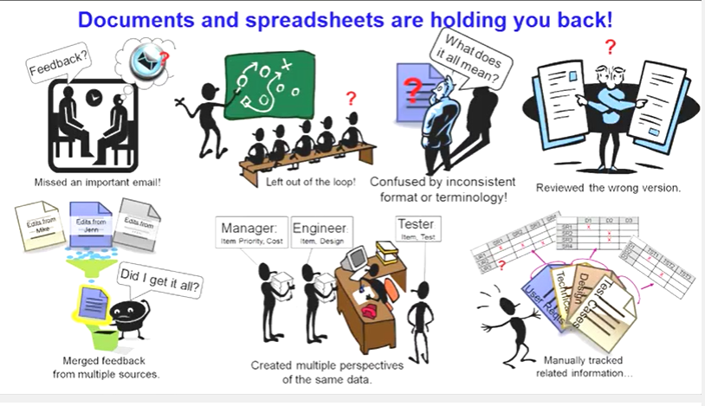
INCONSISTENCY WITH THE TRADITIONAL APPROACH

Slide 2
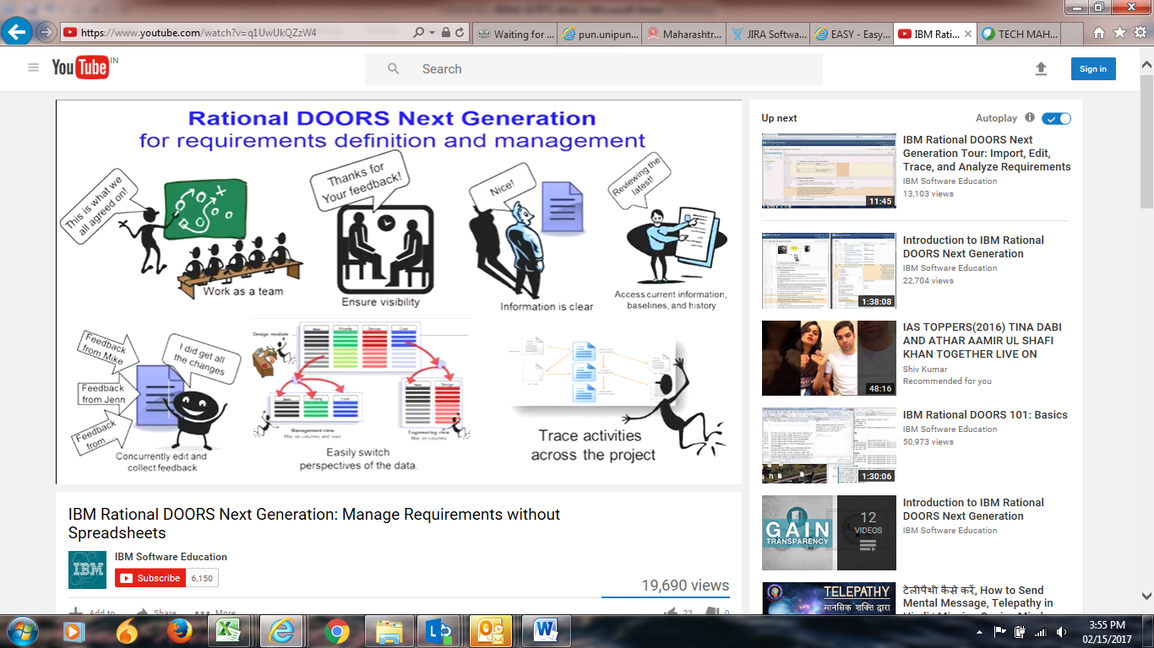
RATIONAL DOORS –STREAMLINING THE REQUIREMENTS CAPTURING PROCESS

Slide 3
IBM RDNG
Objective -Making Data Work for you
LIVE COLLABORATION
TRACEABILITY AND CONSISTENCY
UNDERSTANDING CHANGE
STAY ON TOP OF PROJECT PROGRESS
TROUBLE SHOOT PROJECT PROGRESS

Slide 4
IBM RTC
Objective – Plan, Track work Item, Manage Source Code and Build Management
Project Transparency
Customizable web based dashboards
Real time metrics and reports
Project milestone tracking and status
SCM
Work Items
Build
Integrated stream management
Identifies component in streams and available baselines
Server-based sandboxes
Component level baselines
Work Item [Task/Defect/Epic] enhancements
Support for approvals and discussions
Query results view and share queries with team
Work item and change set traceability
Local or remote build servers
Supports ant and command line tools
Build definitions for team

Slide 5
Thank you

